Slide 1



Focal Plane Actuation to Achieve Ultra High Resolution on Suborbital Balloon Payloads
Priya Challa
Dr. Paul Scowen
School of Earth and Space Exploration
Arizona State University
April 12, 2014

Slide 2
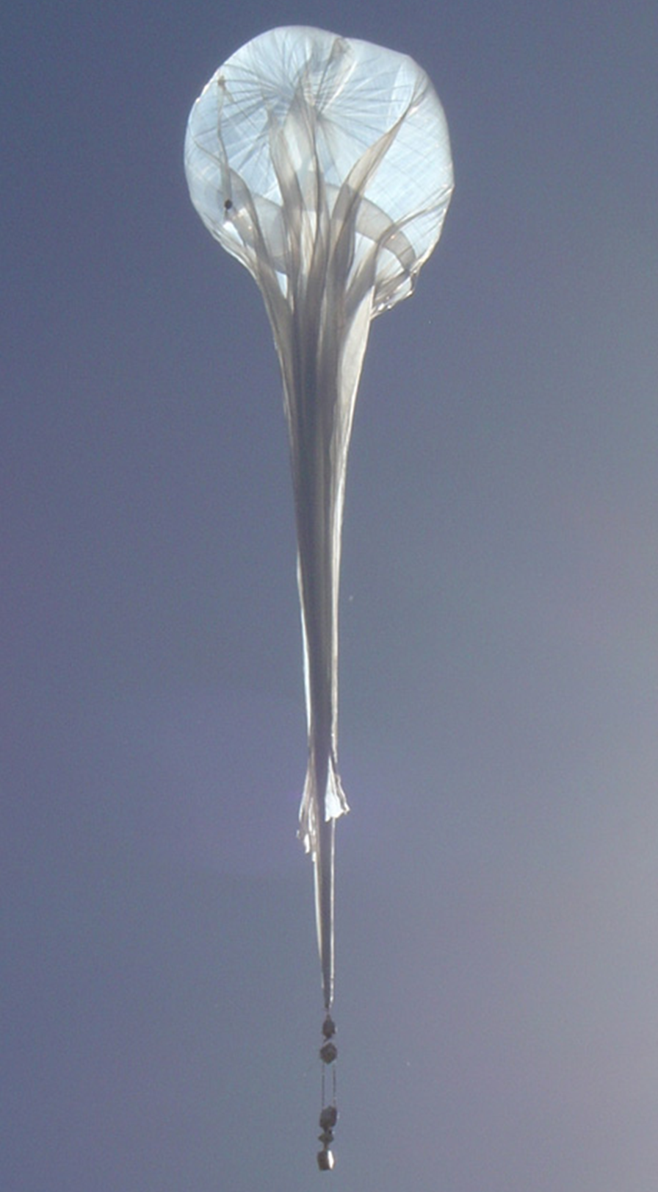
Introduction
Suborbital balloon telescopes can provide image quality that is comparable to that of space based telescopes.
Their angular resolution is limited by the interference of small scale jitter from payload vibrations and differential heating.
Source: nasa.gov

Slide 3
Objectives
This project aims to counteract the jitter by actuating the focal plane and reducing the total pointing error for the telescope+camera to within 0.1 arcseconds.
The goal is to reduce the residual physical focal plane motion to less than 6.5 μm so that the jitter induced spread in the point spread function is contained within one pixel.

Slide 4
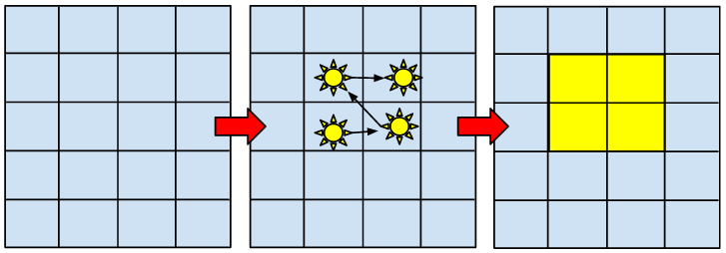
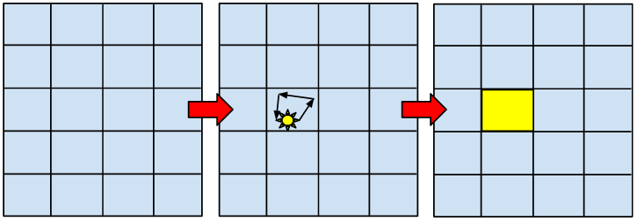
Motion of CCD during exposure
Illuminated pixels
Pixel Array
Without jitter mitigation
With jitter mitigation
Notes:
Jitter is caused by thermal variations and the operation of instruments in the payload itself.

Slide 5
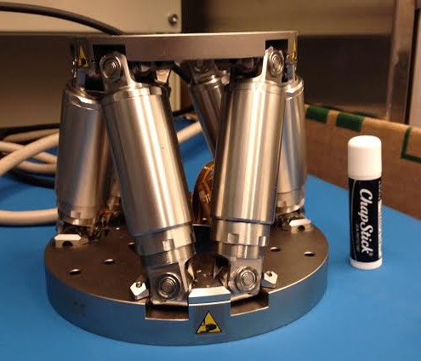
Methods
The focal plane will be actuated using an off-the-shelf hexapod, which offers six degree-of-freedom (DOF) motion control.

Slide 6
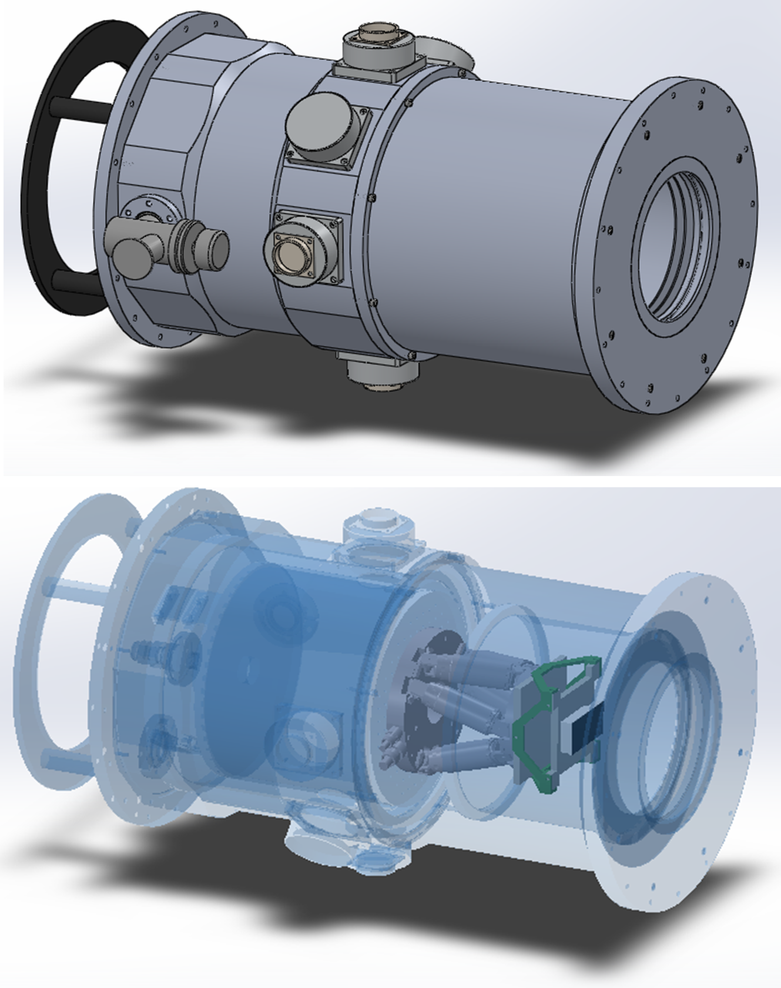
Methods
The CCD must be cooled to cryogenic temperatures while the hexapod has only been designed to operate at room temperature.
Thermal isolation is achieved by innovative design choices within the dewar mount.

Slide 7
Thermal Isolation
Convection is eliminated by the introduction of a vacuum environment.
A layer of G10 fiberglass prevents conductive heat transfer.
Radiation shielding is used to prevent heat from the hexapod from interfering with the CCD.

Slide 8
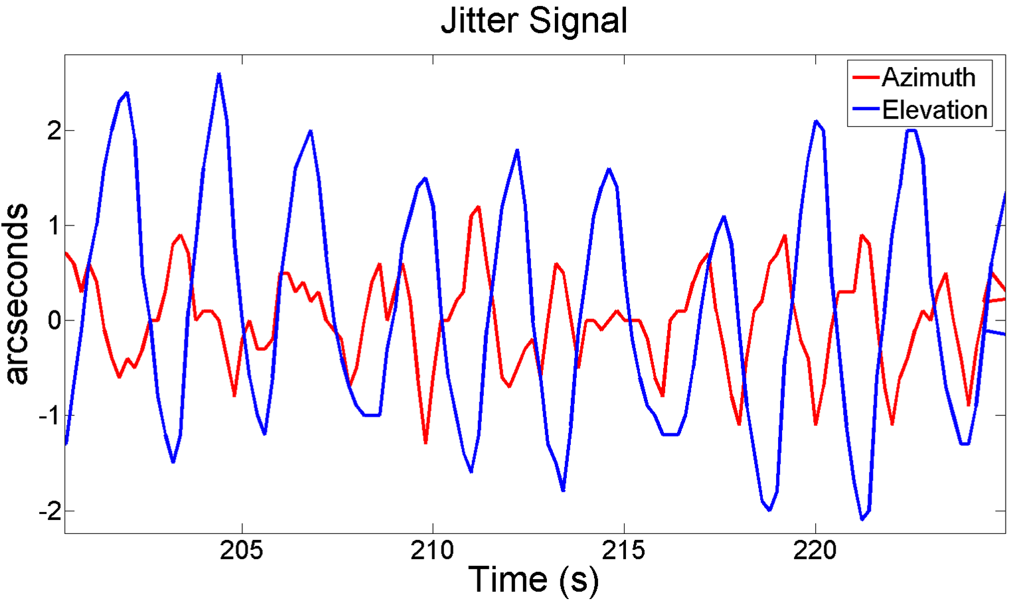
Experimental Setup
A similarly actuated target will be driven using the same jitter from a past balloon mission.

Slide 9
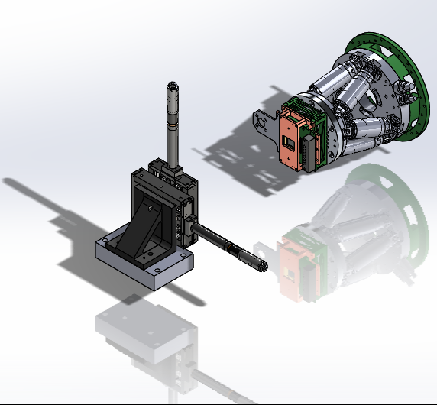
Experimental Setup
To verify that the hexapod system works, the mounted CCD must provide a clear image of the target.
Notes:
NASA standard image target will be used.

Slide 10
Applications
Planetary Science
Near Earth Object (NEO) detection
Adaptive Optics

Slide 11
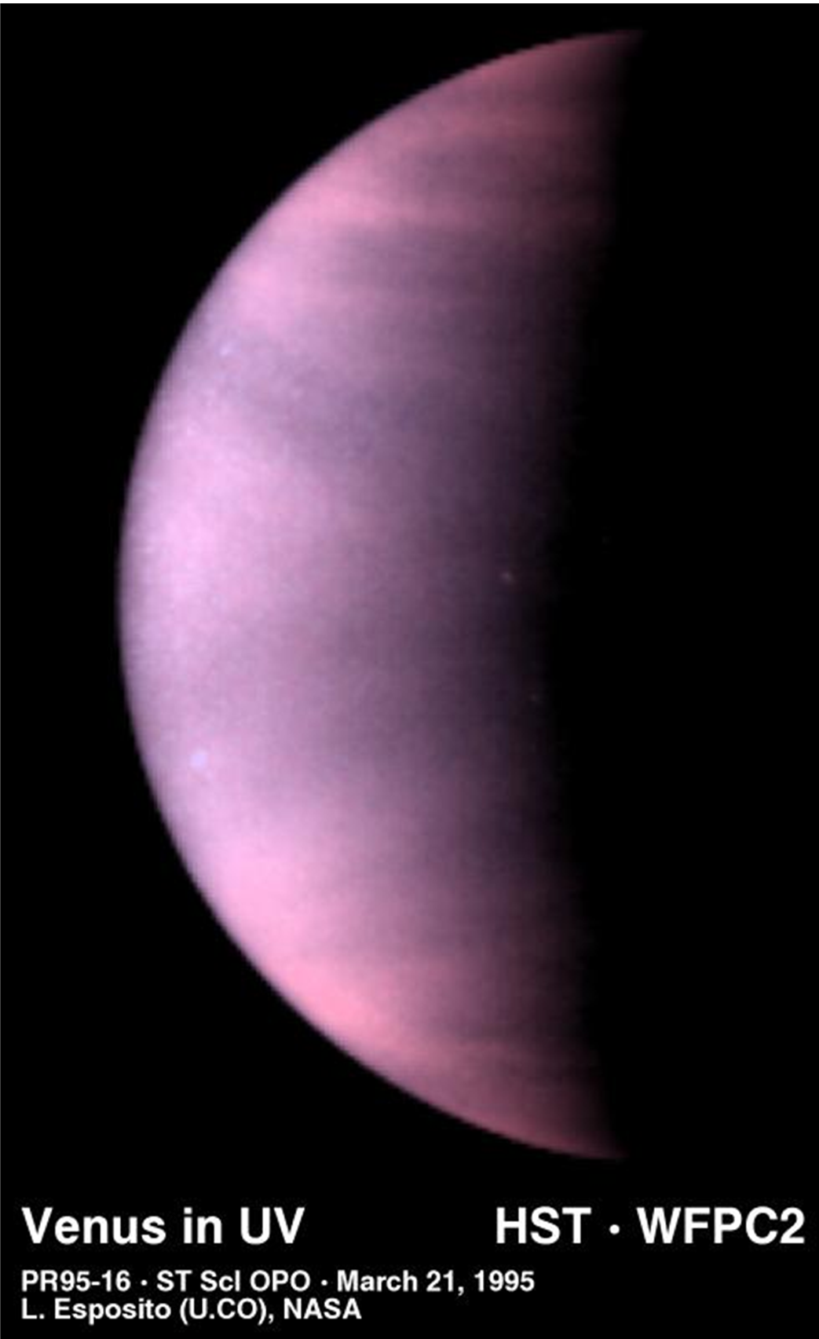
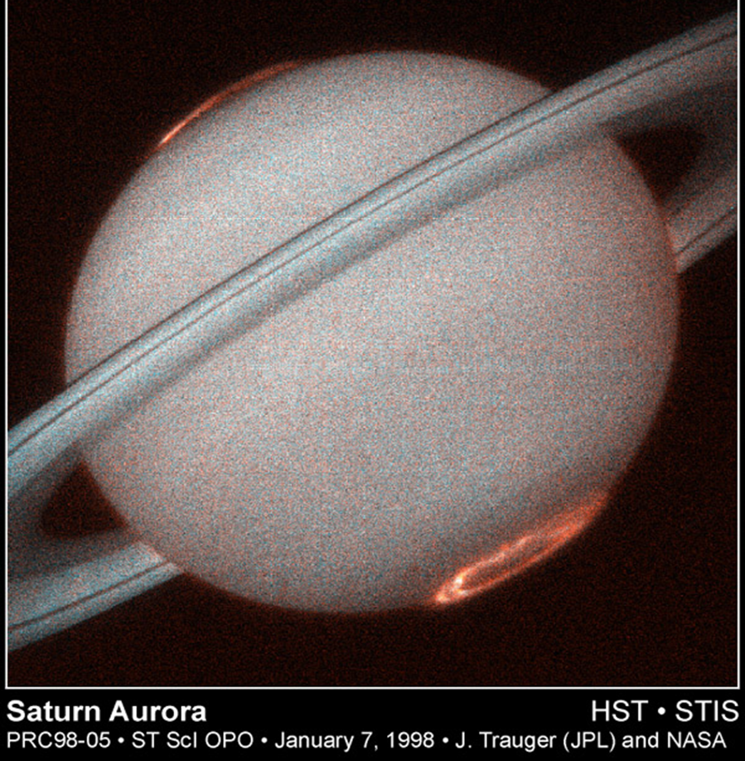
Planetary Science
Provides a platform for long term observation of planets.
Source: hubblesite.org
Notes:
Observation time is very limited on the Hubble Space Telescope and other space based platforms. Balloon-borne telescopes can continuously observe one target for extended periods of time.

Slide 12
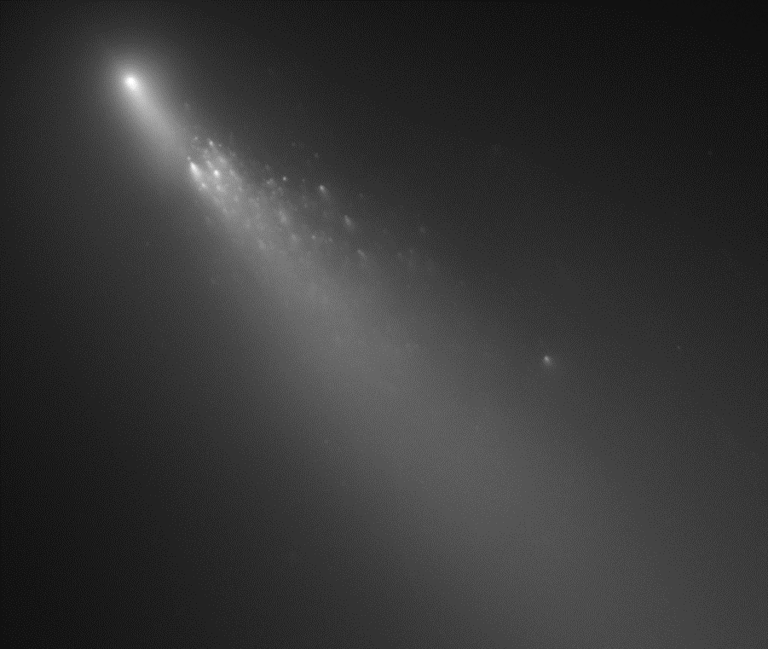
NEO detection
Current NEO surveys are mostly ground based operations.
Balloon telescopes can be flown at almost any altitude and offer comprehensive coverage.
Source: hubblesite.org

Slide 13
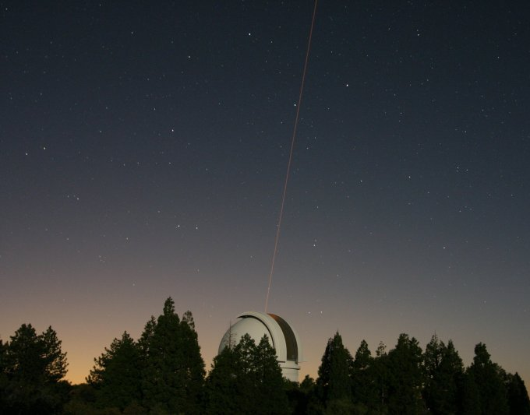
Adaptive Optics
This system could provide a portable adaptive optics system that can be easily transferred between ground based observatories.
Source: jpl.nasa.gov

Slide 14
Questions?

